Slide 1
Micro Services
SAGA Pattern

Slide 2
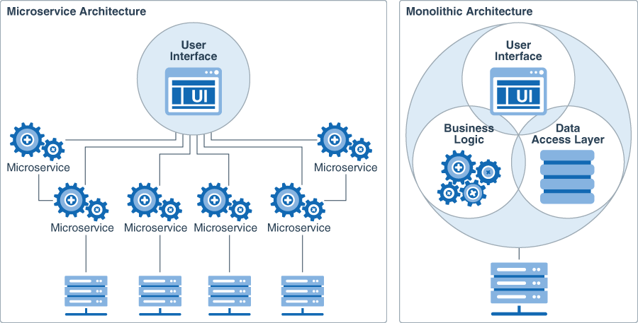

Slide 3
What is SAGA?
SAGA is a design style used to preserve data consistency across several services.
Sequence of transactions running across multiple decoupled services

Slide 4
When to use this pattern?
Use the saga pattern when you need to:
Ensure data consistency in a distributed system without tight coupling.
Roll back or compensate if one of the operations in the sequence fails.
The saga pattern is less suitable for:
Tightly coupled transactions.
Compensating transactions that occur in earlier participants.
Cyclic dependencies.

Slide 5
Types of SAGA
Choreography – each local transaction publishes domain events that trigger local transactions in other services
Orchestration – an orchestrator (object) tells the participants what local transactions to execute

Slide 6
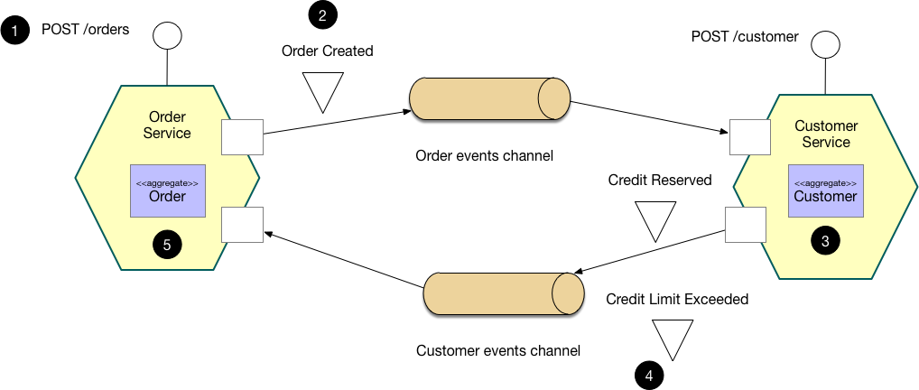
Choreography based saga

Slide 7
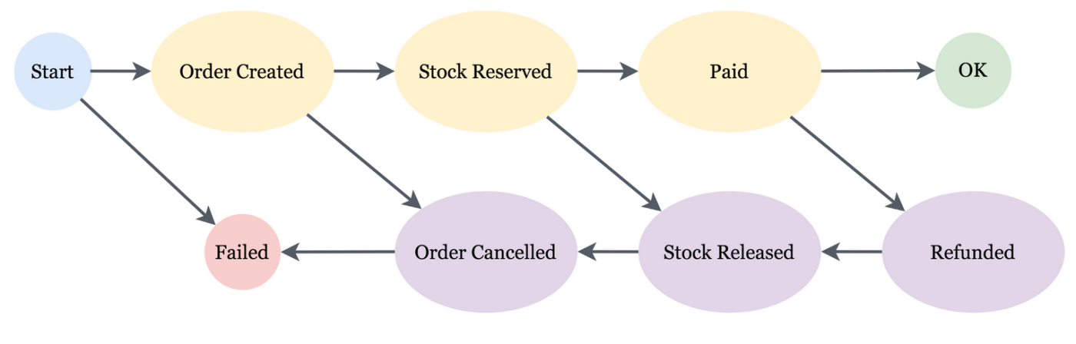

Slide 8
Benefits and Drawbacks
Benefits
Good for simple workflows that require few participants and don't need a coordination logic.
Doesn't require additional service implementation and maintenance.
Doesn't introduce a single point of failure, since the responsibilities are distributed across the saga participants.
Drawbacks
Workflow can become confusing when adding new steps, as it's difficult to track which saga participants listen to which commands.
There's a risk of cyclic dependency between saga participants because they have to consume each other's commands.
Integration testing is difficult because all services must be running to simulate a transaction

Slide 9
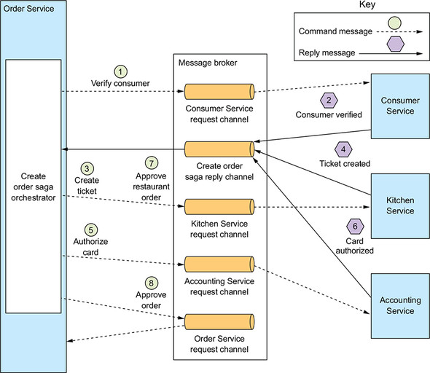
Orchestration-based saga

Slide 10
Benefits and Drawbacks
Benefits
Good for complex workflows involving many participants or new participants added over time.
Suitable when there is control over every participant in the process, and control over the flow of activities.
Doesn't introduce cyclical dependencies, because the orchestrator unilaterally depends on the saga participants.
Saga participants don't need to know about commands for other participants. Clear separation of concerns simplifies business logic.
Additional design complexity requires an implementation of a coordination logic.
There's an additional point of failure, because the orchestrator manages the complete workflow.
Drawbacks

Slide 11
References:
https://docs.microsoft.com/en-us/azure/architecture/reference-architectures/saga/saga
https://blog.imixs.org/2020/05/04/microservice-saga-pattern-with-imixs-workflow/
https://livebook.manning.com/book/microservices-patterns/chapter-4/110
http://chrisrichardson.net/post/microservices/2019/07/09/developing-sagas-part-1.html
https://medium.com/@ijayakantha/microservices-the-saga-pattern-for-distributed-transactions-c489d0ac0247
https://www.ibm.com/cloud/architecture/architectures/event-driven-saga-pattern/
https://ramanisandeep.wordpress.com/2020/06/21/distributed-transaction-in-microservices-using-saga-pattern/
https://www.prakharsrivastav.com/posts/saga-orchestration-in-microservices/
https://microservices.io/patterns/data/saga.html

